Slide 1
Chapter 12
Models of Computation

Slide 2
Learning Objectives (1 of 3)
Explain the purpose of constructing a model
List the required features of a computing agent
Describe the components of a Turing machine, and explain how it is a good model of a computing agent
List the features of an algorithm, and explain how a Turing machine program matches them
Simulate the operation of a simple Turing machine on specific inputs

Slide 3
Learning Objectives (2 of 3)
Construct a simple Turing machine from a specification, both writing the rules and drawing the state diagram
State the Church–Turing thesis and explain what it means
Justify why computer scientists believe the Church–Turing thesis is true
Explain what an unsolvable problem is
Describe the halting problem, what its inputs and outputs are

Slide 4
Learning Objectives (3 of 3)
Outline the proof that the halting problem cannot be solved by any Turing machine

Slide 5
Introduction
There are some problems that have a solution we haven’t found yet
There are problems that have no algorithmic solution
We can prove that no algorithm could ever exist to solve certain problems
To study what computing agents can and cannot do, we must strip them down to bare essentials
Create an “ideal” computing agent, a model of a computing agent

Slide 6
What Is a Model?
A model of something
Captures the essence of the real thing
Differs in scale from the real thing
Omits some details of the real thing
Lacks some of the functionality of the real thing
Models can be used to predict behavior
Look at the model’s behavior
May be safer, less expensive, less difficult than the real thing
Models let us test something without building it

Slide 7
A Model of a Computing Agent (1 of 9)
What are key features of a computing agent?
Read input data
Store and retrieve information in memory
Act in accordance with algorithm instructions.
Output results

Slide 8
A Model of a Computing Agent (2 of 9)
Turing machine: a model of a computing agent
Has a tape, infinite in both directions
Each cell of the tape holds one symbol
Tape alphabet: finite set of symbols for tape
Tape holds input and memory and prints output
Has finite number of internal states, 1 to k
Instructions for a machine:
Examine current tape symbol and current state
Write new tape symbol, change state, and move left or right one cell

Slide 9
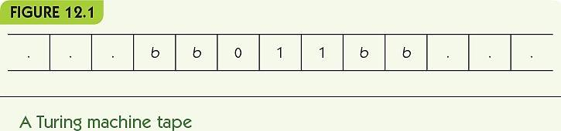
A Model of a Computing Agent (3 of 9)

Slide 10
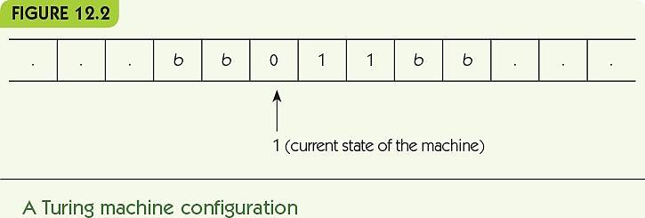
A Model of a Computing Agent (4 of 9)

Slide 11
A Model of a Computing Agent (5 of 9)
Turing machine instructions
if (in state i) and (reading symbol j) then
Write symbol k onto tape
Change to state s
Move in direction d
Encode this in concise terms:
(I, j, k, s, d)

Slide 12
A Model of a Computing Agent (6 of 9)
Example:
(1, 0, 1, 2, right)
if (state=1) and (input=0)
write 1
change into state 2
move right

Slide 13
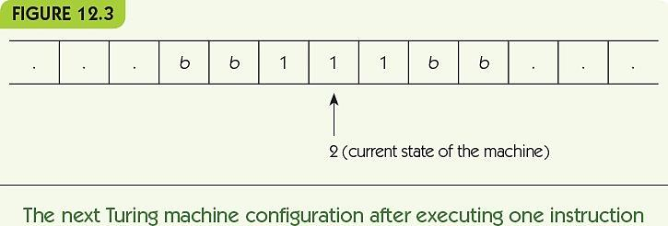
A Model of a Computing Agent (7 of 9)

Slide 14
A Model of a Computing Agent (8 of 9)
Turing machine program: a set of rules
Must begin in state 1
Machine always starts reading leftmost symbol in the input
Avoid ambiguity
No two rules with the same state and input
If no rule applies, machine halts

Slide 15
A Model of a Computing Agent (9 of 9)
A Turing machine is a good model of a computing agent
It reads input from its tape
It uses its tape as memory and can read from and write to it
It takes actions based on its state and its input
It can produce output, on its tape

Slide 16
A Model of an Algorithm (1 of 4)
Is a Turing machine program a model of an algorithm?
A model of an algorithm must:
Be a well-ordered collection
Consist of unambiguous and effectively computable operations
Halt in a finite amount of time
Produce a result

Slide 17
A Model of an Algorithm (2 of 4)
A well-ordered collection
The starting state and position on the tape are well-defined
At most one rule can match a given state and position
It is well defined what happens if no rule matches
A Turing machine knows where to start, and what step to do next

Slide 18
A Model of an Algorithm (3 of 4)
Consists of unambiguous and effectively computable operations
Turing machine instructions completely specify what the machine must do
Turing machine instructions cannot be ambiguous
Halts in a finite amount of time
Turing machines can go into infinite loops, like poor attempts at algorithms
We can ensure halting for inputs within the scope of the problem

Slide 19
A Model of an Algorithm (4 of 4)
Produces a result
The contents of the tape when the Turing machine halts are the output
Thus, a Turing machine program is a good model of an algorithm!

Slide 20
Turing Machine Examples (1 of 15)
Examples showing what Turing machines can do
Bit inverter
Parity bit
Unary increment
Unary addition
Note: a state diagram is a visual representation of a Turing machine algorithm

Slide 21
Turing Machine Examples (2 of 15)
Bit inverter
Given a string of 0s and 1s, change every 0 to a 1 and every 1 to a 0
Algorithm idea: move right, flipping each bit as it goes, and stop when you reach a blank
Include no rule that responds to a blank symbol, and the machine must stop when input ends

Slide 22
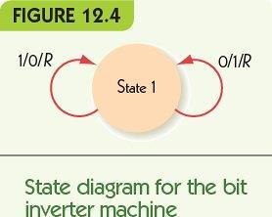
Turing Machine Examples (3 of 15)
Rules:
(1, 0, 1, 1, R)
(1, 1, 0, 1, R)

Slide 23
Turing Machine Examples (4 of 15)
Bit inverter example
Each row shows contents of tape after a move
Head position is shown in bold, always in state 1
… | b | 1 | 1 | 0 | 1 | b | …
… | b | 0 | 1 | 0 | 1 | b | …
… | b | 0 | 0 | 0 | 1 | b | …
… | b | 0 | 0 | 1 | 1 | b | …
… | b | 0 | 0 | 1 | 0 | b | …

Slide 24
Turing Machine Examples (5 of 15)
Parity bit problem
Given a string of 0s and 1s,
Count whether the number of 1s is even or odd
If it is even, add a 1 to the end of the string
Else add a 0 to the end of the string
Algorithm idea
State 1 represents even parity so far
State 2 represents odd parity so far
Reading 0 doesn’t change the state
Reading 1 changes from state 1 to 2 and vice versa

Slide 25
Turing Machine Examples (6 of 15)
Rules:
(1, 1, 1, 2, R)
(1, 0, 0, 1, R)
(2, 1, 1, 1, R)
(2, 0, 0, 2, R)
(1, b, 1, 3, R)
(2, b, 0, 3, R)

Slide 26
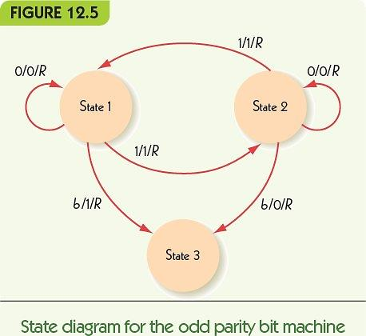
Turing Machine Examples (7 of 15)

Slide 27
Turing Machine Examples (8 of 15)
Parity bit example
Each row shows contents of tape after a move
Head position is shown in bold, state in parentheses
… | b | 1(1) | 0 | 1 | b | b | …
… | b | 1 | 0 (2) | 1 | b | b | …
… | b | 1 | 0 | 1 (2) | b | b | …
… | b | 1 | 0 | 1 | b (1) | b | …
… | b | 1 | 0 | 1 | b(3) | b | …
… | b | 1 | 0 | 1 | 1 | b (3) | …

Slide 28
Turing Machine Examples (9 of 15)
Unary incrementing
Given a unary representation of a number n,
Change the tape to represent n+1
Unary representation: uses one symbol
0 = 1
1 = 11
2 = 111
3 = 1111
Algorithm idea: move to the right end and add a 1

Slide 29
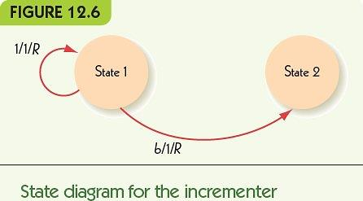
Turing Machine Examples (10 of 15)
Rules:
(1, 1, 1, 1, R)
(1, b, 1, 2, R)

Slide 30
Turing Machine Examples (11 of 15)
Unary Increment example
Each row shows contents of tape after a move
Head position is shown in bold, state in parentheses
… | b | b | 1 (1) | 1 | 1 | b | b | …
… | b | b | 1 | 1 (1) | 1 | b | b | …
… | b | b | 1 | 1 | 1 (1) | b | b | …
… | b | b | 1 | 1 | 1 | b (1) | b | …
… | b | b | 1 | 1 | 1 | 1 | b (2) | …

Slide 31
Turing Machine Examples (12 of 15)
Alternative algorithm
Move left to a blank and add a 1 there
Rules:
(1, 1, 1, 1, L)
(1, b, 1, 2, L)
… | b | b | 1 (1) | 1 | 1 | b | b | …
… | b | b (1) | 1 | 1 | 1 | b | b | …
… | b (2) | 1 | 1 | 1 | 1 | b | b | …

Slide 32
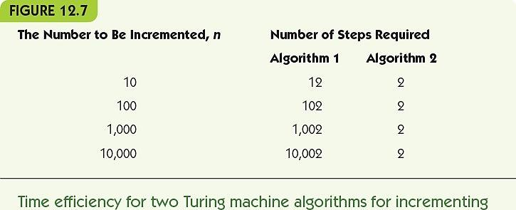
Turing Machine Examples (13 of 15)
Algorithm 1 efficiency: length of input plus 2
Algorithm 2 efficiency: exactly 2 steps

Slide 33
Turing Machine Examples (14 of 15)
Unary addition
Given a unary representation of two numbers n and m, separated by one blank on the tape,
Change the tape to represent n+m
Algorithm idea
Erase leftmost 1
Erase second-to-left 1
Find blank in the middle
Change it to a one

Slide 34
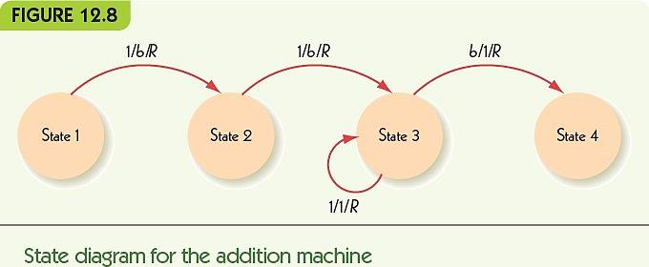
Turing Machine Examples (15 of 15)
Rules:
(1, 1, b, 2, R) (3, 1, 1, 3, R)
(2, 1, b, 3, R) (3, b, 1, 4, R)

Slide 35
The Church–Turing Thesis (1 of 3)
For tasks where input and output may be represented symbolically, are there problems Turing machines can’t solve that algorithms can, or vice versa?
Answer: Church–Turing Thesis
If there exists an algorithm to do a symbol manipulation task, then there exists a Turing machine to do that task.
“Thesis”: Not proven, perhaps not provable

Slide 36
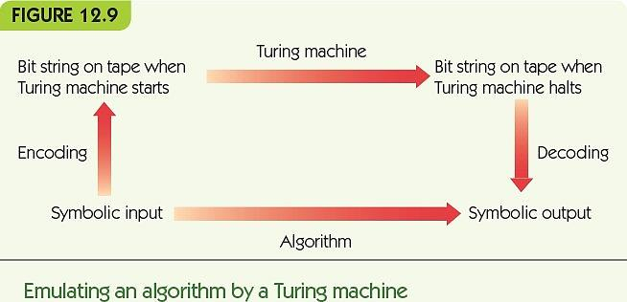
The Church–Turing Thesis (2 of 3)

Slide 37
The Church–Turing Thesis (3 of 3)
Turing machines define the limits of what can be computed: computability
If a problem cannot be solved by a Turing machine, then it cannot be solved algorithmically
It is uncomputable or unsolvable

Slide 38
Unsolvable Problems (1 of 9)
Turing machines may not halt when given inappropriate input
Example: If input is 1 only, what happens?
(1, 1, 0, 2, R)
(1, 0, 1, 2, R)
(2, b, b, 1, L)
(2, 0, 0, 2, R)

Slide 39
Unsolvable Problems (2 of 9)
Halting problem
Given a Turing machine program and its input, will it halt when run on the input?
The halting problem is unsolvable
Prove it by proving no algorithm exists
Proof by contradiction: assume the opposite of proof goal and show a contradiction result

Slide 40
Unsolvable Problems (3 of 9)
Proof: the halting problem is unsolvable
Assume P is a Turing machine that solves the halting problem
P’s input is an encoding of a Turing machine T in binary, T*, and an encoding of the input t in binary
P outputs 1 if T halts when run on t
P outputs 0 if T does not halt on t

Slide 41
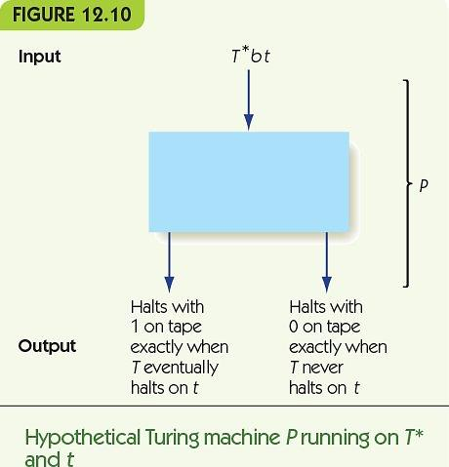
Unsolvable Problems (4 of 9)

Slide 42
Unsolvable Problems (5 of 9)
Build a copy of P, called Q
Q is identical, except where P would halt, Q moves to the right infinitely
For every missing rule in P, in state s with input i, add a rule:
(s, i, i, 52, R), where 52 is a new state
Add a move-forever rule:
(52, b, b, 52, R)

Slide 43
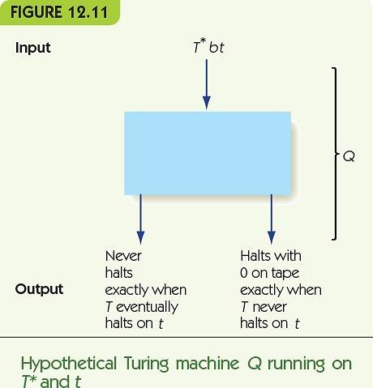
Unsolvable Problems (6 of 9)

Slide 44
Unsolvable Problems (7 of 9)
Build another Turing machine, S
S takes an input, W, and copies W on the tape: WbW
Then S runs Q, with T* = W and t = W
(Does machine W halt when given itself?)
S’s result
S does not halt if machine W halts on input W
S halts if machine W does not halt on input W

Slide 45
Unsolvable Problems (8 of 9)
What happens if we run S on its own encoding, S*?
S copies S* on the tape and runs Q on S*bS*
By its definition,
If S halts on input S*, then S does not halt on S*
If S does not halt on input S*, then S does halt on S*
Contradiction!

Slide 46
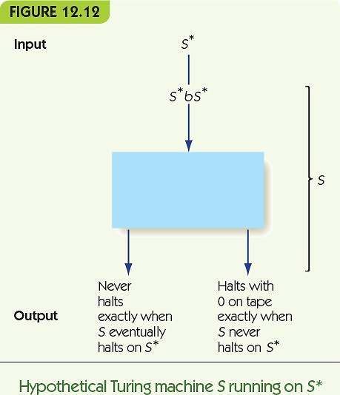
Unsolvable Problems (9 of 9)

Slide 47
Summary (1 of 2)
Models allow us to predict behavior and serve as a testbed
A model of a computing agent must take input, have memory and state, and produce output
Turing machines have:
An infinite tape for input and memory
A finite number of states
Rules for changing states based on state and input, write on the tape, and move left or right
Turing machines are a computing agent model

Slide 48
Summary (2 of 2)
Turing machine programs are the sets of instructions of a machine
Turing machine programs model algorithms
Examples of Turing machine programs include bit invert, parity bit, unary increment, unary addition,
The Church–Turing thesis says that any algorithm can be performed by a Turing machine
Some problems have no algorithmic solution
The halting problem is one that cannot be solved by a Turing machine, it is unsolvable

